Slide 1
ADMIN
OVERHAUL
Notes:
The legendary Einstein once stated...
“Learn from yesterday, live for today, hope for tomorrow. The important thing is not to stop questioning”
So we did not stop questioning…
Why are we wasting time and resources in this golden age of technology and information?
Greetings my fellow peers and good mam.
My forward thinking teammates and I are enthusiastic to reveal our computer science concept “ADMIN OVER HAUL”
There was an idea... to bring together a group of remarkable programmes... to see if they could become something more... To see if they could work together when we needed them to... to facilitate the overseer’s operations that were considered tedious before...

Slide 2
Initiate_

Slide 3
INDEX
FEATURES
CONCLUSION
01
02
03
04
INTRODUCTION
ABOUT OUR PROJECT
Notes:
Welcome
During this presentation you, the audience, will be lead through our 4 phases
A brief intro to our project
A basic understanding of the tools and techniques utilized during our project
an indepth look at the process of creating and applying our programs
Lastly, we will leave you with a final outlook and a public service announcement regarding our current pandemic situation.

Slide 4
Introduction
Notes:
Corona has affected all of us and we have been attending online college until now and probably will for another few months
It is very likely that when we begin offline college psg will require us to get the covid vaccine and upload our certificates online.
So colleges will likely also commission a multi person workforce to retrieve specific data about the thousands of students attending the college and verify their corona vaccine certificates… all manually.
So if u have not caught on, the gist is we are most simply trying to automate this entire process
Basically a Admin Assistor if u will.
We created a couple programs for every aspect of an admins procedure,
When put together they are powerful and finish the tasks that take days for humans into measly minutes

Slide 5

Language Used
Python is a widely used general-purpose, high level programming language.
Python
VERSION USED-3.9.5
COMPILER USED-IDLE, TERMINAL
Notes:
The programming language used during this project is Python
Python is a widely used general purpose, high level programming language
Python allows programming in Object-Oriented and Procedural paradigms
The biggest strength of Python is huge collection of standard library which can be used for :Machine learning ,gui applications ,web frameworks ,web scraping etc.

Slide 6



FEATURES
Web Scraping
Email Automation
QR detector
Extraction of Data from the Web
Sending emails using python
Verifying Authenticity
Notes:
Let’s take a look at the tools and techniques applied during our process
We extracted data from the website using web scraping.
We created an automated email system to deliver emails to the right person at the right time.
We programmed a qr code detector that verifies the authenticity of the certificates provided.
Now we will be giving a brief but informative explanation of these features.

Slide 7
Web Scraping_Decoded

Slide 8

What is Web Scraping?
Web Scraping is a process of automating the extraction of data efficiently
With help of web scraping, you can extract data from any website, no matter how large is the data, on your computer
That data then can be used for any kind of data manipulation and operation on it.
Notes:
Let’s say, data is vital for your e-commerce company.
You are able to see the data on your competitor’s website.
The question is how will you download it in a usable format?
Most people would be able to only copy and paste it manually. However, it is not feasible to do it for large websites with hundreds of pages.
Moreover, websites may have data that you cannot copy and paste.
This is where web scraping comes into play.
Web Scraping is a process of automating the extraction of data in an efficient and fast way. With the help of web scraping, you can extract data from any website, no matter how large is the data on your computer.and then data can be used for any kind of data manipulation and operation on it.
In simple terms, web scraping saves you the trouble of manually downloading or copying any data and automates the whole process.

Slide 9
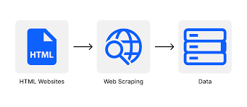
How does it work?
Web Scrapers will be given specific URLs or a whole list to scrape data
Web scrapers gather website data in the same way a human would do it.
It goes onto a web page, gets the relevant data and move forward to next page
Finally the scraper will run and let the user download the data as Excel sheet or other formats
Notes:
In most cases, web scrapers will be given a specific URL (or a whole list) to scrape data from.
It will then make a HTTP request to a server.
Web scrapers gather website data in the same way a human would do it: the scraper goes onto a web page of the website, gets the relevant data, and move forward to the next web page.
This is process is known as parsing or extraction of the website’s code
Lastly, the scraper will run and let the user download the data as Excel sheet or other formats.

Slide 10
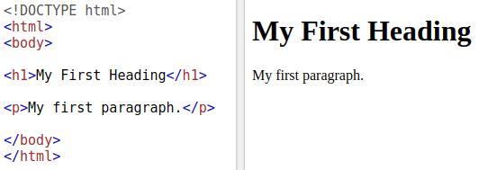
How does it work?
Important issues that arise when implementing a web scraper:
What is the structure of the web pages containing the data
How can we get to those pages
We need to understand how websites work to answer the above.
They are created using HTML, CSS, and JS.
HTML elements are separated by tags and introduce content to web page.
Here is what a basic HTML document looks like:
Notes:
DONE
Every website has a different structure, that is why web scrapers are usually built to explore one website.
The two important issues that arise during the implementation of a web scraper are the following:
What is the structure of the web pages that contain relevant data?
How can we get to those web pages?
In order to answer those questions, we need to understand a little how websites work.
Websites are created using HTML , along with CSS and JavaScript. HTML elements are separated by tags and they directly introduce content to the web page.
Here is what a basic HTML document looks like:
We can see that the content of the first heading is contained between the ‘h1’ tags and The first paragraph is contained between the ‘p’ tags.
On a real website, we need to find out between which tags the relevant data is and tell it to our scraper.
We also need to specify which links should be explored and where they can be found among the HTML file.
With all this information, our scraper should be able to gather the required data.
I would like to humbly request the audience to shift your attention to my renowned colleague and fellow programmer, Yadav Ranga Nathan

Slide 11

What tools are used?
Web scraping usually requires some knowledge of programming languages
The most popular for the task being PYTHON.
Python comes with tons of open-source libraries
Notes:
Thankyou Adrash Boopathi for covering the basics on how to scrape the web for data…
But now, thinking about how this works from a technical perspective (back to slide)
LET’S TAKE A LOOK AT A FEW POPULAR ONES!

Slide 12
Beautifulsoup
Scrapy
PYTHON
LIBRARIES
Pandas
Selenium
Notes:
Here are the names of some commonly used and popular python libraries

Slide 13
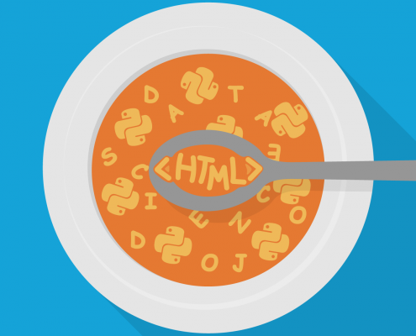

COMMON LIBRARIES USED
BeautifulSoup
Scrapy
A python library use to parse data from HTML and XML documents
Organizes parsed content in to trees
Go-to tool for many data analysts
Python based application framework that crawls and extracts data from web
Commonly used for data mining, information processing
Notes:
BeautifulSoup is a Python library, commonly used to parse data from XML and HTML documents. Organizing this parsed content into more accessible trees, BeautifulSoup makes navigating and searching through large swathes of data much easier. It’s the go-to tool for many data analysts.
Scrapy is a Python-based application framework that crawls and extracts structured data from the web. It’s commonly used for data mining, information processing, and for archiving historical content. As well as web scraping (which it was specifically designed for).

Slide 14


Pandas
Selenium
Another multi-purpose Python library used for data manipulation and indexing.
It can be used in junction with BeautifuLSoup
Is a web browser automation tool
It allows to open a browser of your choice and perform tasks as a human being would
Notes:
Ok now, Pandas is another multi-purpose Python library used for data manipulation and indexing. It can be used to scrape the web in conjunction with BeautifulSoup and the main benefit of using pandas is that analysts can carry out the entire data analytics process using one language
Selenium is a Web Browser Automation Tool.
Which is primarily used for automating web applications for testing purposes
It allows you to open a browser of your choice & perform tasks as a human being would, such as:
Clicking buttons
Entering information in forms
Searching for specific information on the web pages
The selenium package we have used is to automate web browser interaction from Python

Slide 15

APPLICATIONS OF WEB SCRAPING
Price intelligence:
This is the most used case for web scraping
Extracting product and pricing info and turning it into intelligence is very important
Helps ecommerce companies make better pricing and marketing decisions
Education/Academics:
Depends a lot on data, revolving largely around information
Academics have to get hold of data and process to arrive at necessary insights, whether a teaching assignment or a research project
Notes:
Price intelligence
price intelligence is the biggest use case for web scraping. Extracting product and pricing information from e-commerce websites, then turning it into intelligence is an important part of modern e-commerce companies that want to make better pricing/marketing decisions based on data.
Academic
Academic world depends a lot on data. Academic work revolves largely around one or the other kind of information.
Whether it’s a teaching assignment or a research project, academics have to get hold of data and then process it in order to arrive at the necessary insights.
Web scraping has now made it extremely easier for them to extract and process the data they need.

Slide 16

News and Content
Monitoring:
For A company that depends on timely news analyses, or frequently appears on the news, web scraping is the ultimate solution
It will help with monitoring, aggregating, and parsing the most critical stories from the industry
Brand Monitoring:
In a highly competitive market it is top priority to protect online reputation
Whether you sell your products online and have a strict pricing policy that you need to enforce or just want to know how people perceive your products online, web scraping will be useful
Notes:
News & content monitoring
Modern media can create outstanding value or an existential threat to your business - in a single news cycle. If you’re a company that depends on timely news analyses, or a company that frequently appears in the news, web scraping news data is the ultimate solution for monitoring, aggregating, and parsing the most critical stories from your industry.
Brand monitoring
In today’s highly competitive market, it's a top priority to protect your online reputation. Whether you sell your products online and have a strict pricing policy that you need to enforce or just want to know how people perceive your products online, brand monitoring with web scraping can give you this kind of information.
As the Internet has grown astronomically and businesses have become increasingly dependent on data, it is now a compulsion to have access to the latest data on every given subject.
Data has become the basis of all decision-making processes whether it’s a business or a non-profit organization. Therefore, web scraping has found its applications in every endeavour of note in contemporary times.

Slide 17
Legality and Ethics of Web Scraping
Web scraping code of conduct:
Don't steal: Copyright and fair use
Don't download copies of documents that are clearly not public
Check your local legislation
Don't share downloaded content illegally
Share what you can
Don't break the web: Denial of Service attacks
Publish your own data in a reusable way
View robots.txt file
Legal issues in India
- Leaving a few cases dealing with IPR infringement, Indian courts have not expressly ruled on the legality of web scraping.
- However, since all common forms of electronic contracts are enforceable in India, violating the terms of use prohibiting data scraping will be a violation of the contract law.
- It will also violate the Information Technology Act, 2000, which penalizes unauthorized access to a computer resource or extracting data from a computer resource.
Notes:
Don't steal: Copyright and fair use
Don't download copies of documents that are clearly not public.
Check your local legislation.
Don't share downloaded content illegally.
Share what you can.
Don't break the Internet.
Publish your own data in a reusable way.
View robots.txt file.
Legal issues in India
- Leaving a few cases dealing with IPR infringement, Indian courts have not expressly ruled on the legality of web scraping.
- However, since all common forms of electronic contracts are enforceable in India, violating the terms of use prohibiting data scraping will be a violation of the contract law.
- It will also violate the Information Technology Act, 2000, which penalizes unauthorized access to a computer resource or extracting data from a computer resource.

Slide 18
E-mail Automation_Decoded

Slide 19
What is email automation
Email automation is the process of sending automated email messages to your subscribers based on predefined rules.
The rules might be related to actions your subscribers take while interacting with your emails or when visiting your website.
Email automation is a very powerful process because it can help you send the right message to the right audience without manual interaction.
The most popular email automation tasks are:
Welcome emails
Cart Abandonment emails
Customer follow-up messages
Automated email sales funnels (Email sales funnels and autoresponders)
Notes:
Email automation is the process of sending automated email messages to your subscribers based on pre-defined rules. The rules might be related to actions your subscribers take while interacting with your emails or when visiting your website.
Email automation is a very powerful process because it can help you send the right message to the right audience without manual interaction.
The most popular email automation tasks are:
Welcome emails
Cart Abandonment emails
Customer follow-up messages
Automated email sales funnels (Email sales funnels and autoresponders)

Slide 20

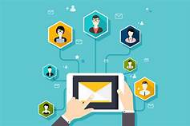
A visitor lands on your website and performs some action.
HOW DOES EMAIL AUTOMATION WORK?
Their contact details are added to your database
They are added to their relevant audience segment based on their actions, location, interests, etc.
You set up rules, conditions, create an automated email marketing campaign that would be sent to your new contact
Your new contact receives a relevant email from you according to the conditions you set up earlier

Slide 21
QR Code Reader_Decoded

Slide 22
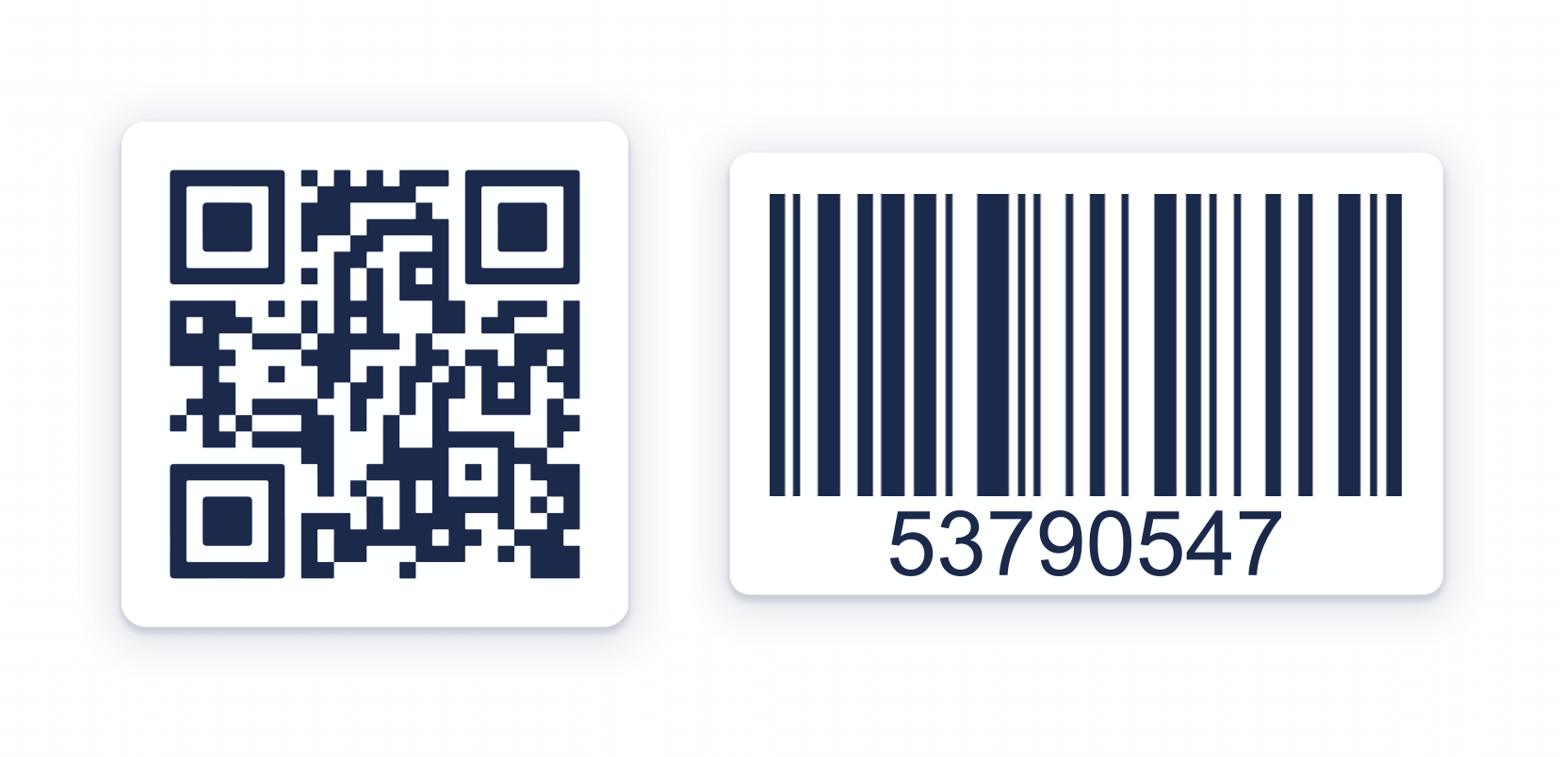
The QR code term stands for Quick Response Code. QR codes are square barcodes (two-dimensional barcodes) that were first developed and used in Japan.
A QR code is nothing more than a way to store information in a machine-readable optical label.
A QR code works in the same way as a barcode at the supermarket.
The modern-day QR Code consists of 7 parts. Each of these parts creates a sort of pixel pattern that looks similar to a crossword puzzle.
Each element has a specific purpose that conveys certain information through the Code.
Notes:
The QR code term stands for Quick Response Code. QR codes are square barcodes (two-dimensional barcodes) that were first developed and used in Japan. Like any other barcode, a QR code is nothing more than a way to store information in a machine-readable optical label.
Basically, a QR code works in the same way as a barcode at the supermarket.
The modern-day QR Code consists of 7 parts. Each of these parts creates a sort of pixel pattern that looks similar to a crossword puzzle.
Each element has a specific purpose that conveys certain information through the Code such as the print direction, timing, error tolerance, and empty spaces to differentiate the Code from what surrounds it.The QR code term stands for Quick Response Code. QR codes are square barcodes (two-dimensional barcodes) that were first developed and used in Japan. Like any other barcode, a QR code is nothing more than a way to store information in a machine-readable optical label.
Basically, a QR code works in the same way as a barcode at the supermarket.
The modern-day QR Code consists of 7 parts. Each of these parts creates a sort of pixel pattern that looks similar to a crossword puzzle.
Each element has a specific purpose that conveys certain information through the Code such as the print direction, timing, error tolerance, and empty spaces to differentiate the Code from what surrounds

Slide 23
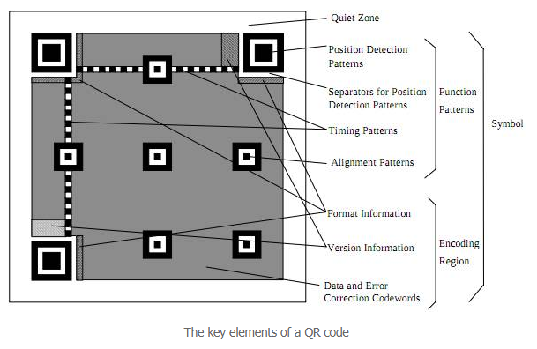
ANATOMY OF QR CODE
A QR code is made up of four main parts:
Finder patterns
Alignment patterns
Timing pattern
The actual data
Notes:
Finder patterns: These are the big black/white/black squares on the three corners on the QR code. These help identify the presence of a QR code in an image and it's orientation. These are made such that they can be detected really fast.
Alignment patterns: These are smaller than finder patterns and help straighten out a QR codes drawn on a curved surface. The larger a code, the more alignment patterns it'll have.
Timing pattern: These are alternating black/white modules on the QR code. The idea is to help figure out the data grid accurately.
The actual data: The blacks/whites form bits. Groups of 8 such modules makes one byte. You could combine 16 modules to get unicode data.

Slide 24
ABOUT THIS PROJECT
Applications of python for administrative assistance.
Automation to ease tedious admin processes
Effectively exploiting the college website.
Notes:
About this project
So in this project we basically explore the applications of python for administrative assistance
And also we try to effectively carry out the automation processes using python
This is done in order to ease the tedious and monotonous job of an admin
And primarily the project efficiently and effectively exploits our own college website.
Basically it can be said that the website is the pillar of our project which we will see in detail in the upcoming slides.

Slide 25
PROCESS
STEP 1
STEP 2
STEP 3
Import Login details from database(excel)
Using the login info to scrape required data
Using the scraped data output as the body of the automated mail
Notes:
So this part of the project consists of three major steps involved
They are:

Slide 26

WEB SCRAPING USING PYTHON
Notes:
So web scraping using python programming language is the primary feature we have implemented in our project.
We already saw abt the working and tools used in web scraping as it was explained by my fellow team members
Now we will see how it has been used in the project

Slide 27
GOAL
Completed and in practice, the program imports the required data directly from the admin database.
This is where the login details are present and is used as input for scraping.
It can be used to scrape various data such as fee details, marks, etc
Currently, the program manages to scrape desired data from the website for a single user given their login details.
Notes:
Goals ….(read)
Development so far…
Still need to program a code which imports data directly from the database(preferably excel)

Slide 28
import selenium
import os
import time
from selenium import webdriver
from selenium.webdriver.common.keys import Keys
chromedriver = '/usr/local/bin/chromedriver'
browser = webdriver.Chrome(chromedriver)
browser.get("https://ecampus.psgtech.ac.in/studzone2/AttWfLoginPage.aspx")
print(browser.title)
search1 = browser.find_element_by_name("txtusercheck")
search1.send_keys("20$$$$")
search1.send_keys(Keys.RETURN)
search2 = browser.find_element_by_name("txtpwdcheck")
PASS= input()
search2.send_keys(PASS)
search2.send_keys(Keys.RETURN)
link = browser.find_element_by_name("abcd3")
link.click()
Notes:
Importing selenium,os and time libraries
From selenium webdriver feature is used
Since we are using google chrome,the chromedriver is used
So basically we are using the html codes of the webpage to build our program
Import keys is used to enter key values
Browser.get- website address
Send_keys-enter value
Inspect element will see a glimpse in the forthcoming vid

Slide 29
academic = browser.find_element_by_id("Title1_Menu1-menuItem002")
academic.click()
feestatus=browser.find_element_by_id("Title1_Menu1-menuItem002-subMenu-menuItem002")
camarks.click()
browser.switch_to.alert.accept()
mytable = browser.find_element_by_id("Tblsemfees")
print(mytable.text)
browser.quit()
Notes:
Similiar to how inspect element tool was used in the login page,we do the same to extract the unique id of each of the command we require to attain our desired data.
In this program the code is used in order to scrape the fee details from our college website

Slide 30

Notes:
Here we can see that inspect element tool is used for building the web scraping program.
As seen in the above code each function or command of the page as a specific name or id
This unique name or id is utilised in order to scrape the desired data we need
Here in login page roll number has specific name “txtusercheck” and pwd has “txtpwdcheck”

Slide 31
Notes:
This video basically demonstrates the program that was explained in the above slides
The code is executed using the terminal.The terminal uses specific commands for executing the code which we would not bother much abt here
So once the code is executed using the terminal(python3 file name) it asks for the password.In practice from an admins POV this pause wont exist because the login details will be directly imported from the database using a program.
But in order to ensure secrecy PASS= input() is used since it asks the pwd as an input from the user.
So after entering the correct password the automation resumes and once the desired data is scraped the browser quits and we obtain the feedetails as highlighted here in the video.
Now in the end process we aim to use this scraped data to be used as the body for the mail which will be automated using python program.

Slide 32
EMAIL AUTOMATION USING PYTHON
Notes:
So the second part of our project is sending automated mails to the students using the scraped data before.
So as my fellow teammate Dharaneesh explained about email automation now yall will be having a basic idea on what it is Now lets see how we implemented this in our project

Slide 33
GOAL
When completed and in practice the program can automatically send mails to numerous students with the scraped data from the previous program as the body of the mail.
Currently, the program manages to send automated mail to multiple recipients using user given subject and body.
Notes:
Basically the main goal of this part of our project is that,

Slide 34
from email.header import Header
from email.mime.text import MIMEText
from getpass import getpass
from smtplib import SMTP_SSL
login,password = 'psgcspro00@gmail.com', getpass('Gmail password:')
msg = MIMEText("We are sorry to inform that 20Z302 has critically low attendance.\nWe are extremely disappointed to inform that 20Z302 won't be able to take his end semester exams.\nHe has also been caught playing VALORANT during class hours,for which actions will be taken accordingly.", 'plain', 'utf-8')
msg['Subject'] = Header("ATTENTION!", 'utf-8')
msg['From'] = login
msg['To'] = "20Z302@psgtech.ac.in"
s = SMTP_SSL('smtp.gmail.com', 465, timeout=10)
s.set_debuglevel(1)
try:
s.login(login, password)
s.sendmail(msg['From'], msg['To'], msg.as_string())
finally:
s.quit()
Notes:
Importing header, MIMEtext, getpass, SMTP_SSL functions from their respective libraries
Giving the mail address and getting password input for the mail to send the automated mails from
MIMEText is basically to type the body of the mail which can also be automated using the scraped data and a loop
Then the subject of the email
And then the mail ID of the person who’s going to be receiving the mail
SMTP is basically the protocol used to send mails and 465 and 10 are some constant values which are required
So once the password is entered and is correct the automated mail will be sent
If the password is incorrect then the program will quit

Slide 35
Notes:
This video basically demonstrates the code that i have explained in the previous slide
Im opening the file with the required code using terminal
Once the file is opened it asks for the gmail password which in this case due to privacy reasons we have to enter but if this is done by an admin the password can be given directly in the code
So after the code gets executed the mail is sent as u can see here and it is already marked as important
You can also compare it with the time stamp

Slide 36
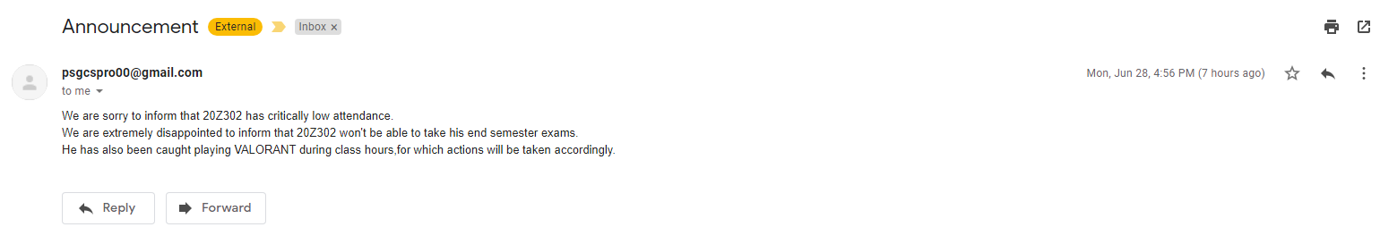
Notes:
This is basically the output of the code that is the same email that was seen in the previous slide in the video
So as i said at the start if we have all the data i.e. attendance, grades, semester fee status, library fee status, which an admin would usually have we can implement all of them in this code and send automated mails to the respective students accordingly
But as we dont have much information now we had to limit our code.
So, Now my teammate Vismayaa will be taking over.

Slide 37
QR CODE DETECTOR/READER USING PYTHON

Slide 38

The SCAM SCANNER
Post Covid-19 the reopening of colleges and universities is a question that doesn’t really offer a simple answer.
In order to ensure safety in the campus following the spike in COVID-19 -19 cases, all educational institutions will ask students to issue their vaccination certificates.
Once the COVID-19 vaccination is completed, a certificate is issued to the citizens as a proof of vaccination.
The vaccination certificate has a secure QR code to protect it against falsification.
In order to reduce the workload of admins, we have developed an admin assistant that will automate the entire process.
Notes:
Because of this situation, we are trying to reduce the workload of admins and create and assistant that will automate the whole process
Lets say there are 5000 students who uploaded their vaccine certificates.
And lets keep it that it takes 2 minute to verify 1 certificate and check if its authentic, and they have 4 people working at the job
5000 times 2 ,it would be a total of 166 hours
The 4 people split it, Lets consider they work 5 hours a day
In the end, it would take a week plus a workforce of 4 people
And our scanner, will automate this and bring the time down to minutes

Slide 39
PROCESS
STEP 1
STEP 2
STEP 3
STEP 4
STEP 5
Students are asked to upload vaccination certificates as images to the college website
Scrape the uploaded image files from the website
Implement the scam scanner to verify authenticity
Notify the same to students through automated mails.
Update status in database

Slide 40
import cv2
img = cv2.imread("/users/girishkrithik/desktop/cv.png")
# initialize the cv2 QRCode detector
detector = cv2.QRCodeDetector()
# detect and decode
data, bbox, straight_qrcode = detector.detectAndDecode(img)
if bbox is not None:
print(f"QRCode data:Successfull\n{data}")
else:
print("Invalid Certificate")

Slide 41
Notes:
Basically demonstrates the code and working of the program upto which we have done so far.
The code is executed using the terminal.

Slide 42
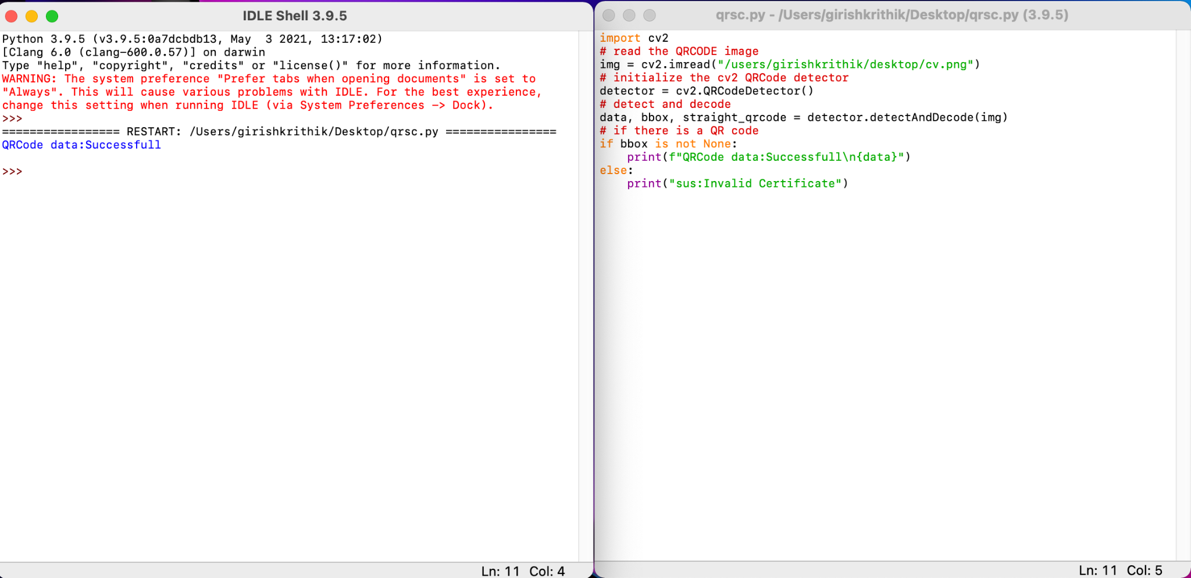
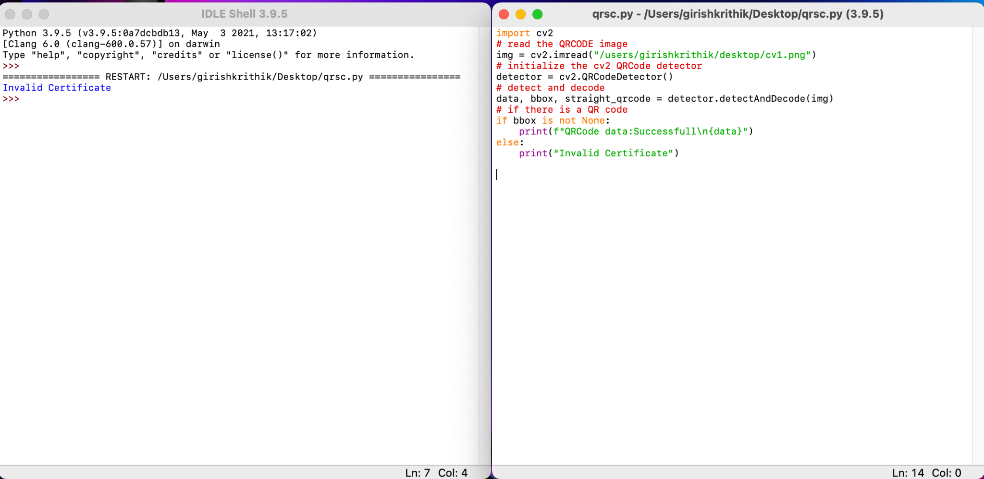
COVID-19 VACCINATION CERTIFICATE IMAGE WITH QR CODE
COVID-19 VACCINATION CERTIFICATE IMAGE WITHOUT/INVALID QR CODE

Slide 43
_Terminate

Slide 44
THANK YOU!
ABINAY ADARSH NARENDRA BOOPATHI BALAKRISHNA VINAY
DHARANEESH.V
GIRISH KRITHIK G.J
NAINASETTY SUJITH
VISMAYAA RAJESH
YADAV RANGANATHAN
(20Z302)
(20Z314)
(20Z317)
(20Z331)
(20Z354)
(20Z355)

